Slide 1
ACTIVATIONS

Slide 2
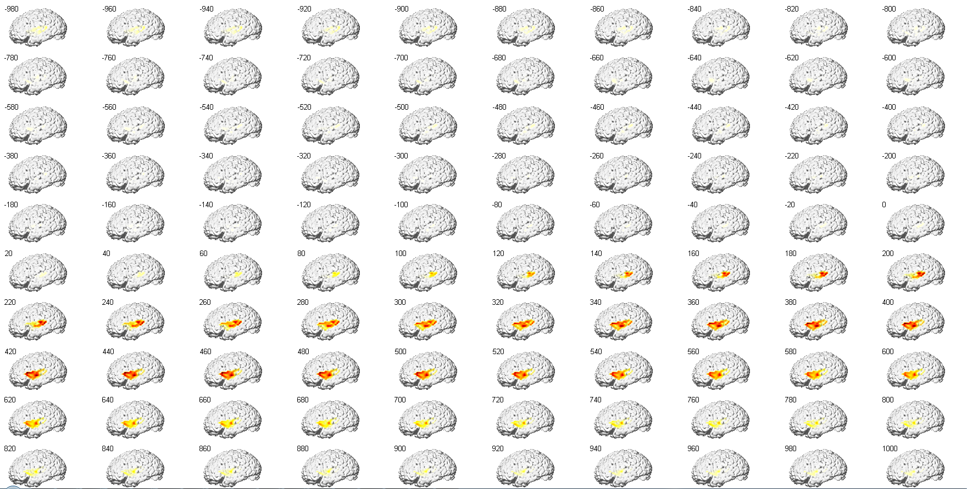
EC18

Slide 3
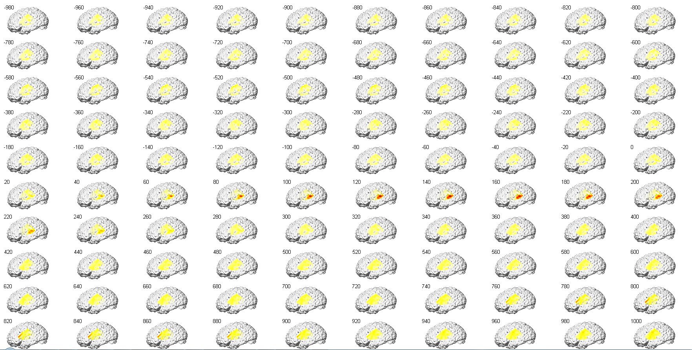
EC18

Slide 4
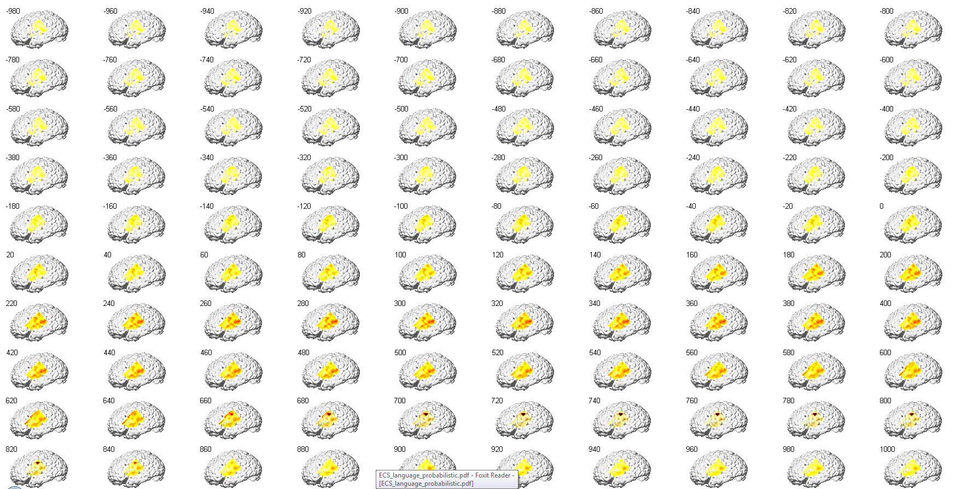
EC18

Slide 5
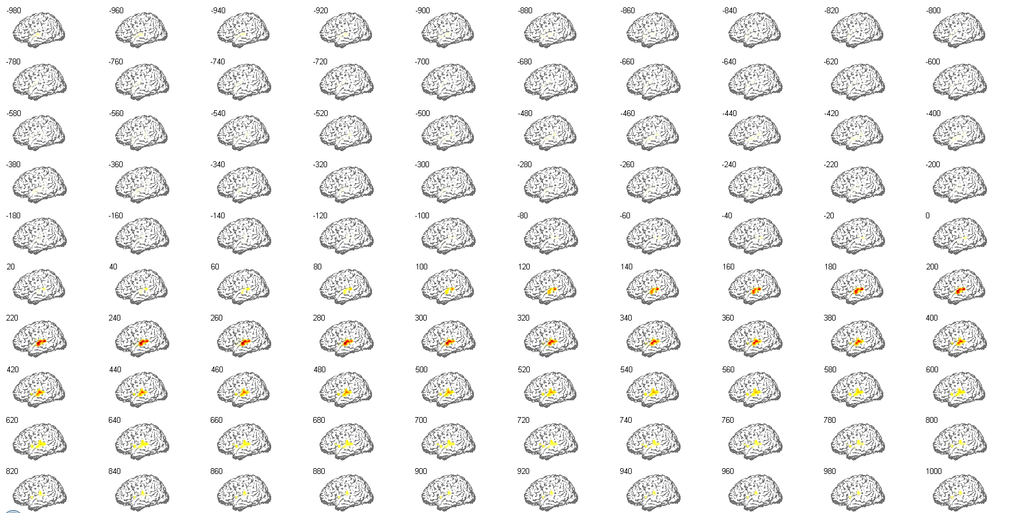
EC16

Slide 6
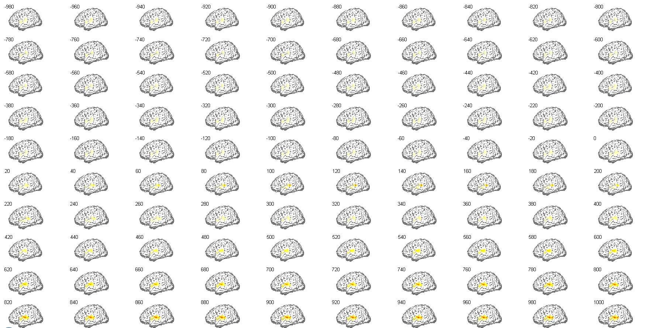
EC16

Slide 7
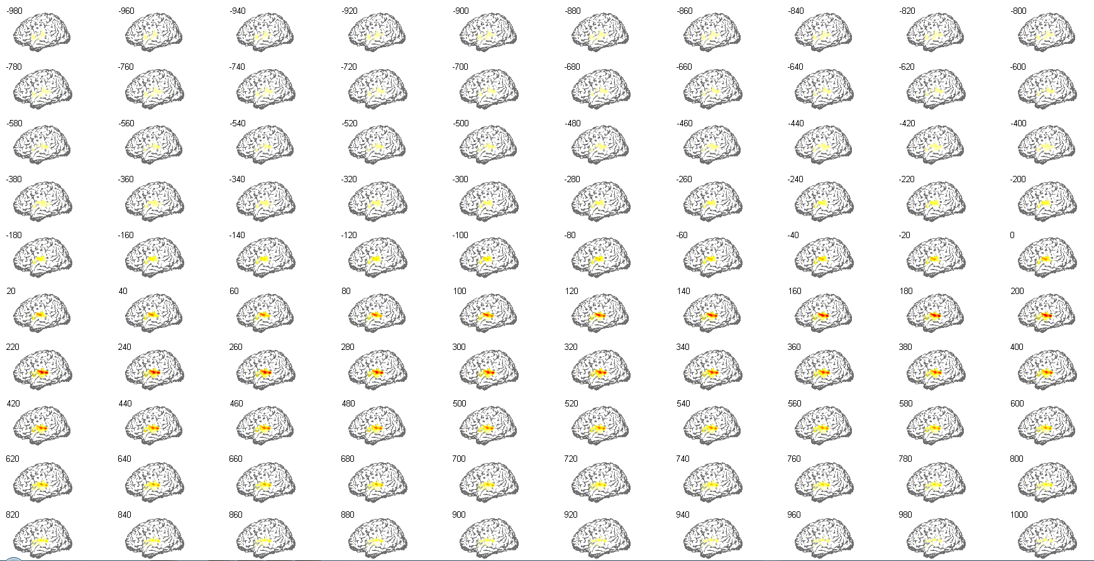
EC16

Slide 8
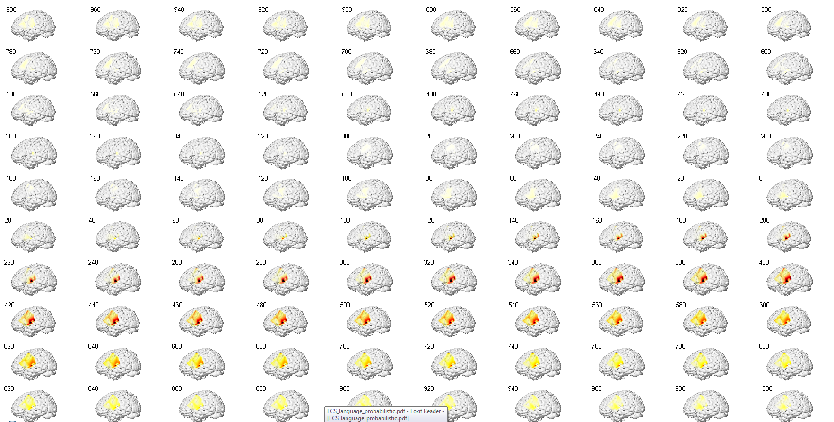
EC22

Slide 9
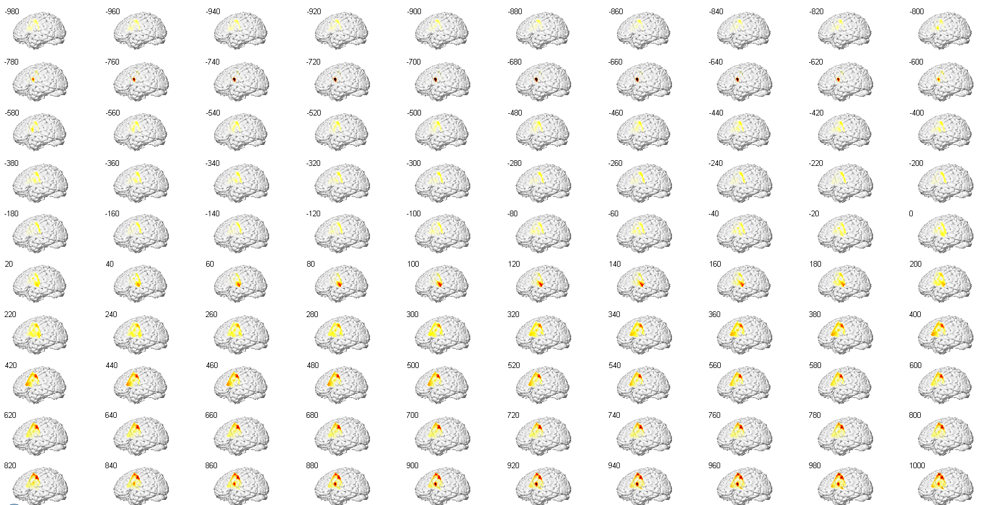
EC22

Slide 10
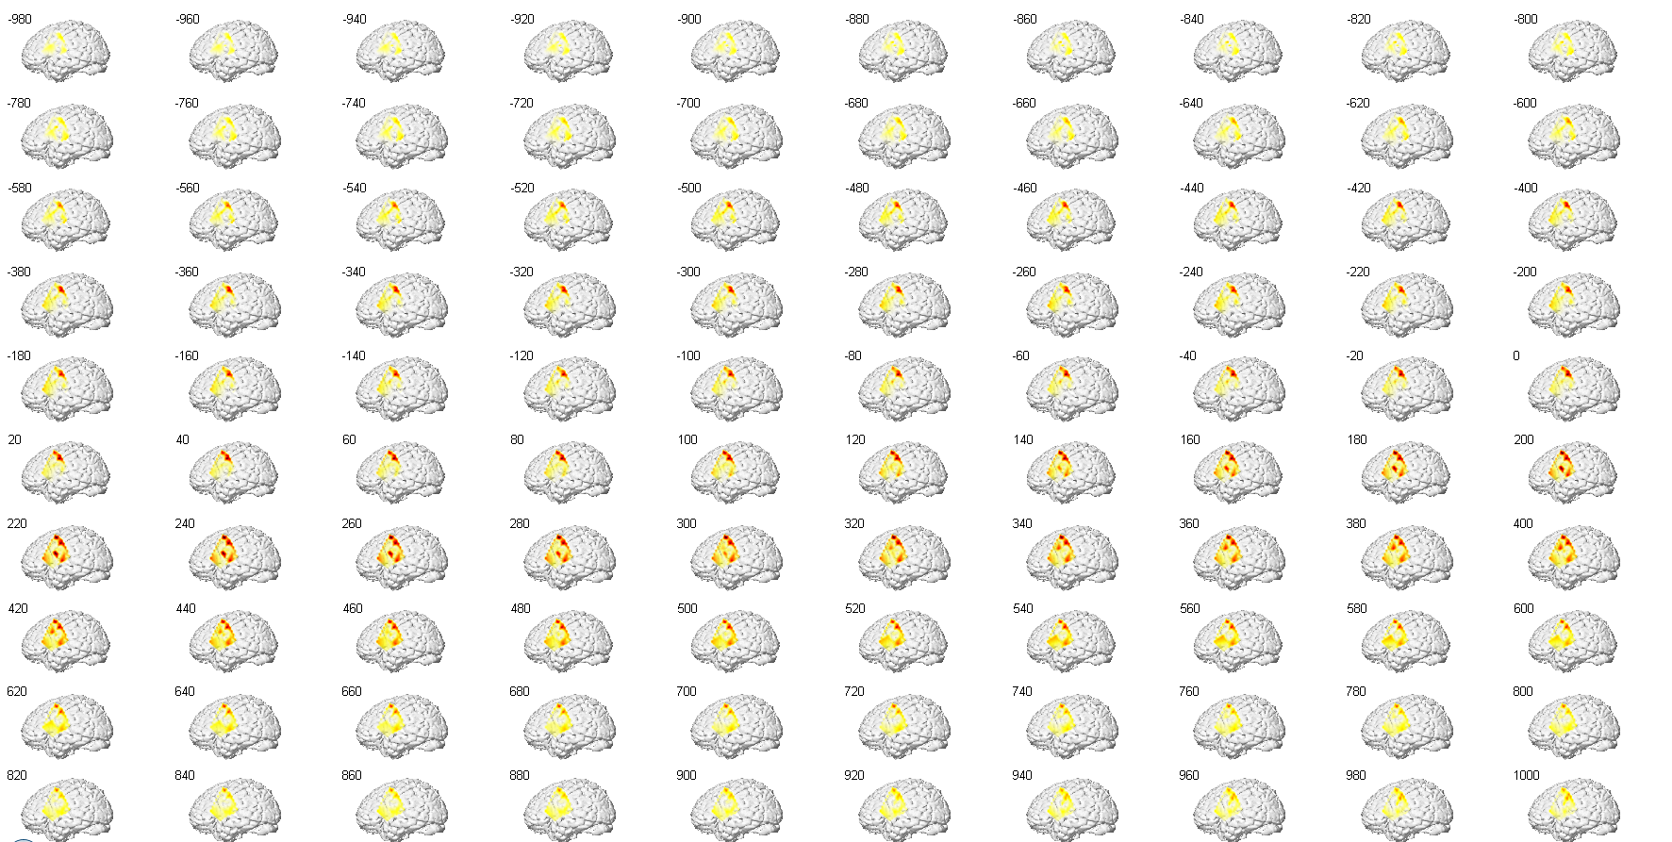
EC22

Slide 11
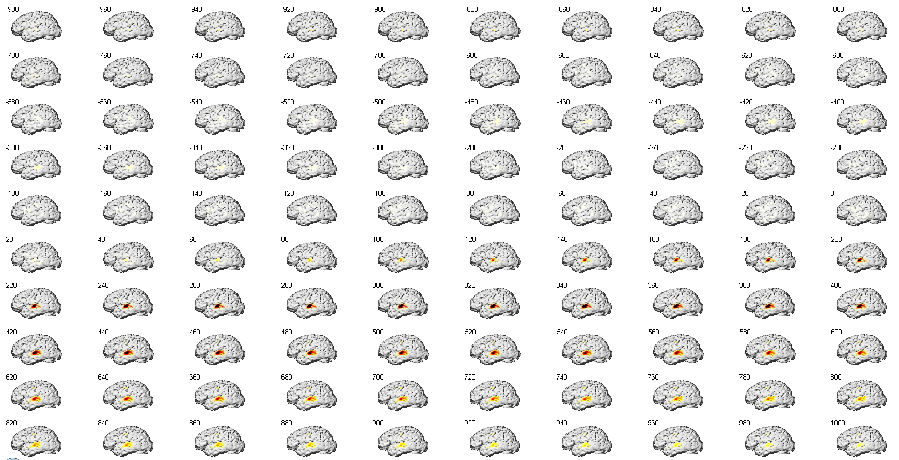
EC23

Slide 12
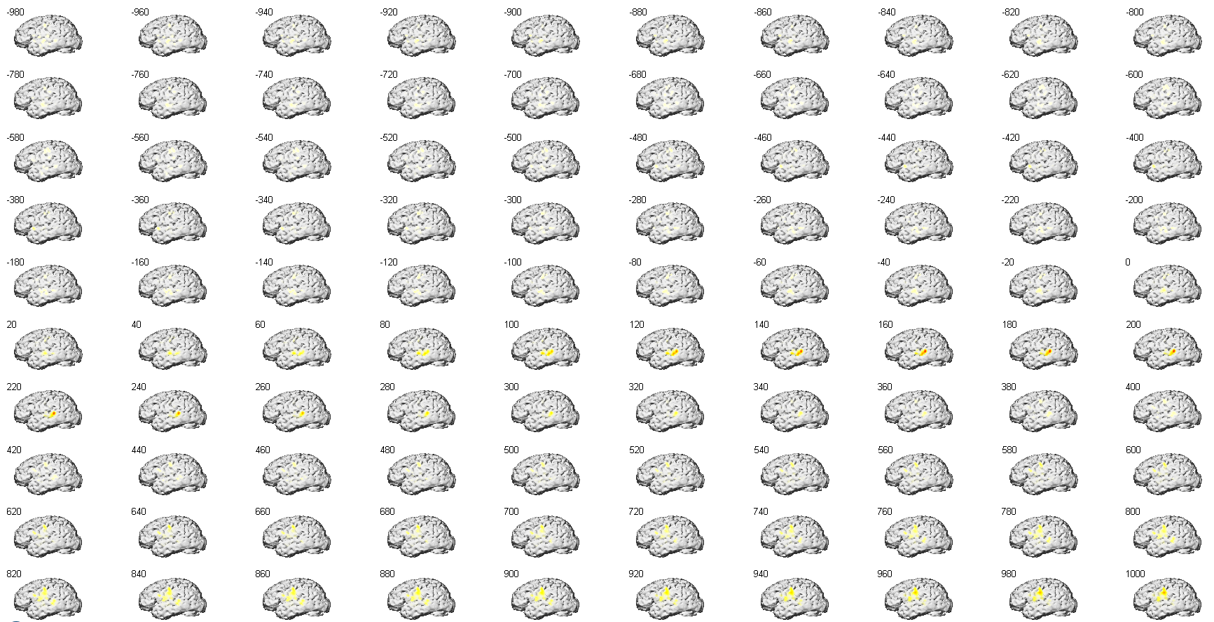
EC23

Slide 13
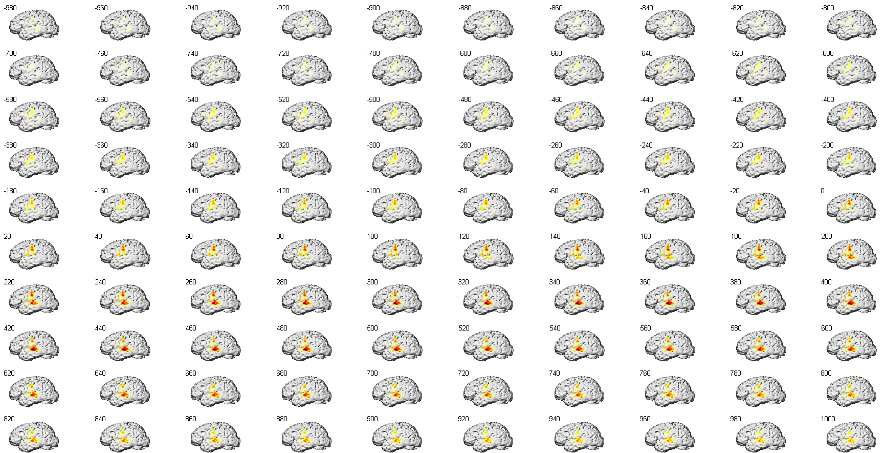
EC23

Slide 14
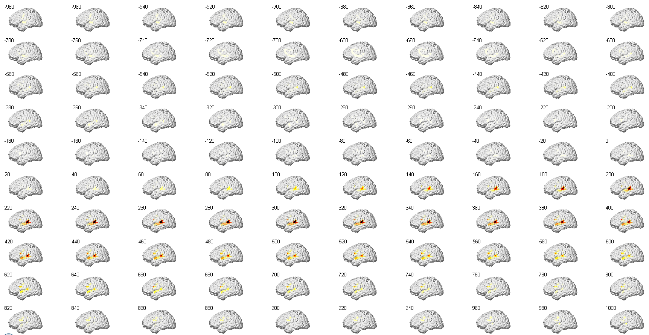
EC24

Slide 15
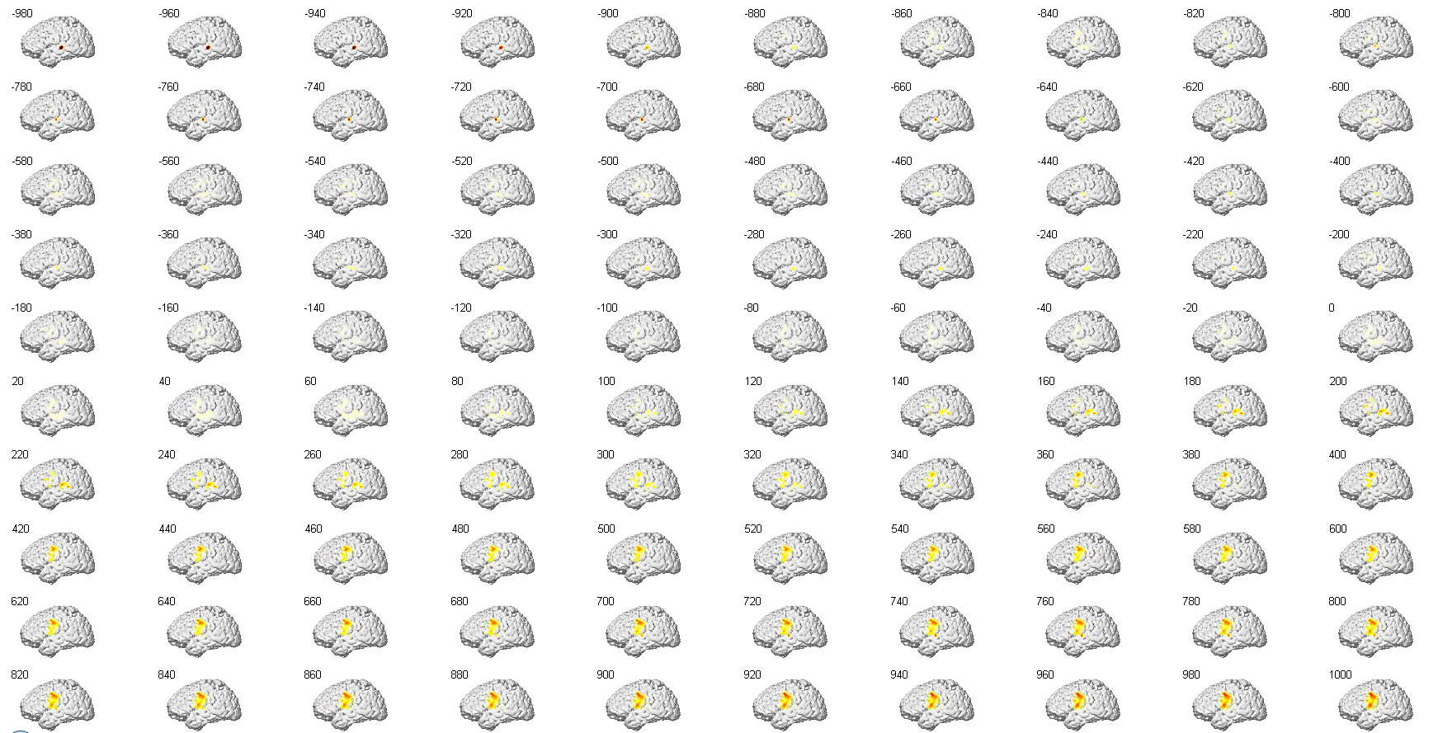
EC24

Slide 16
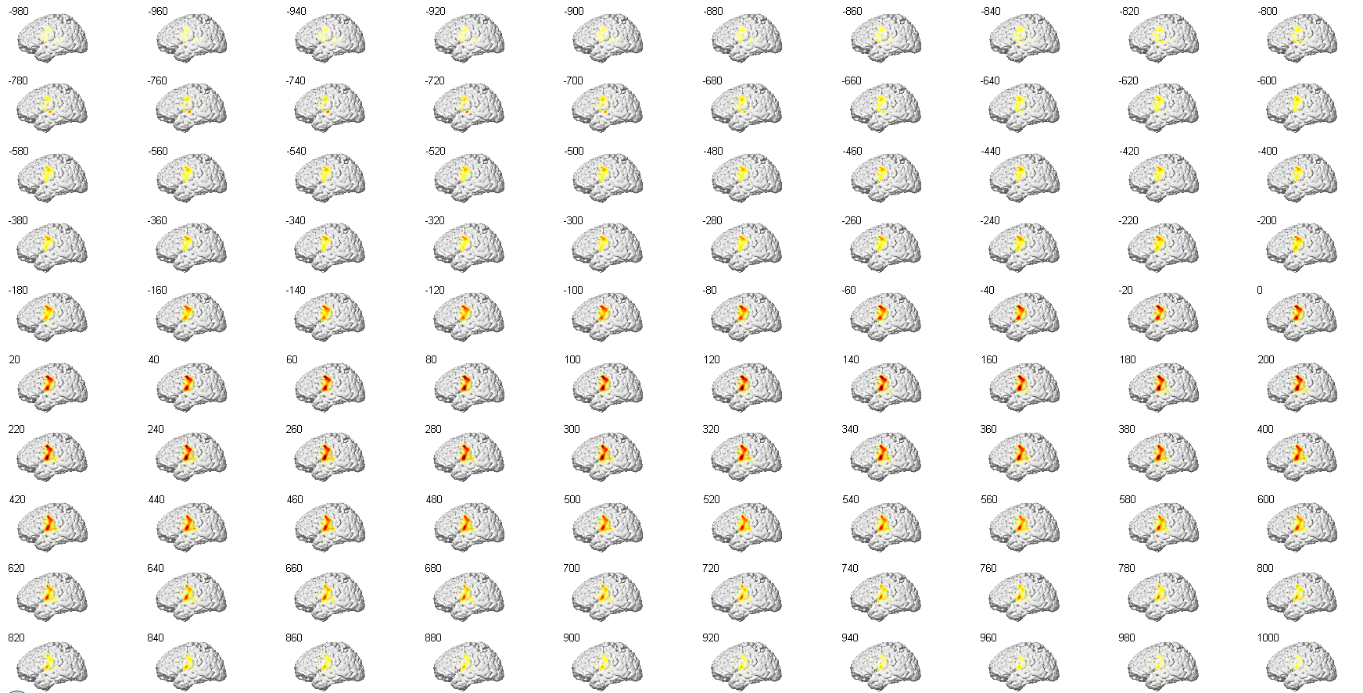
EC24

Slide 17
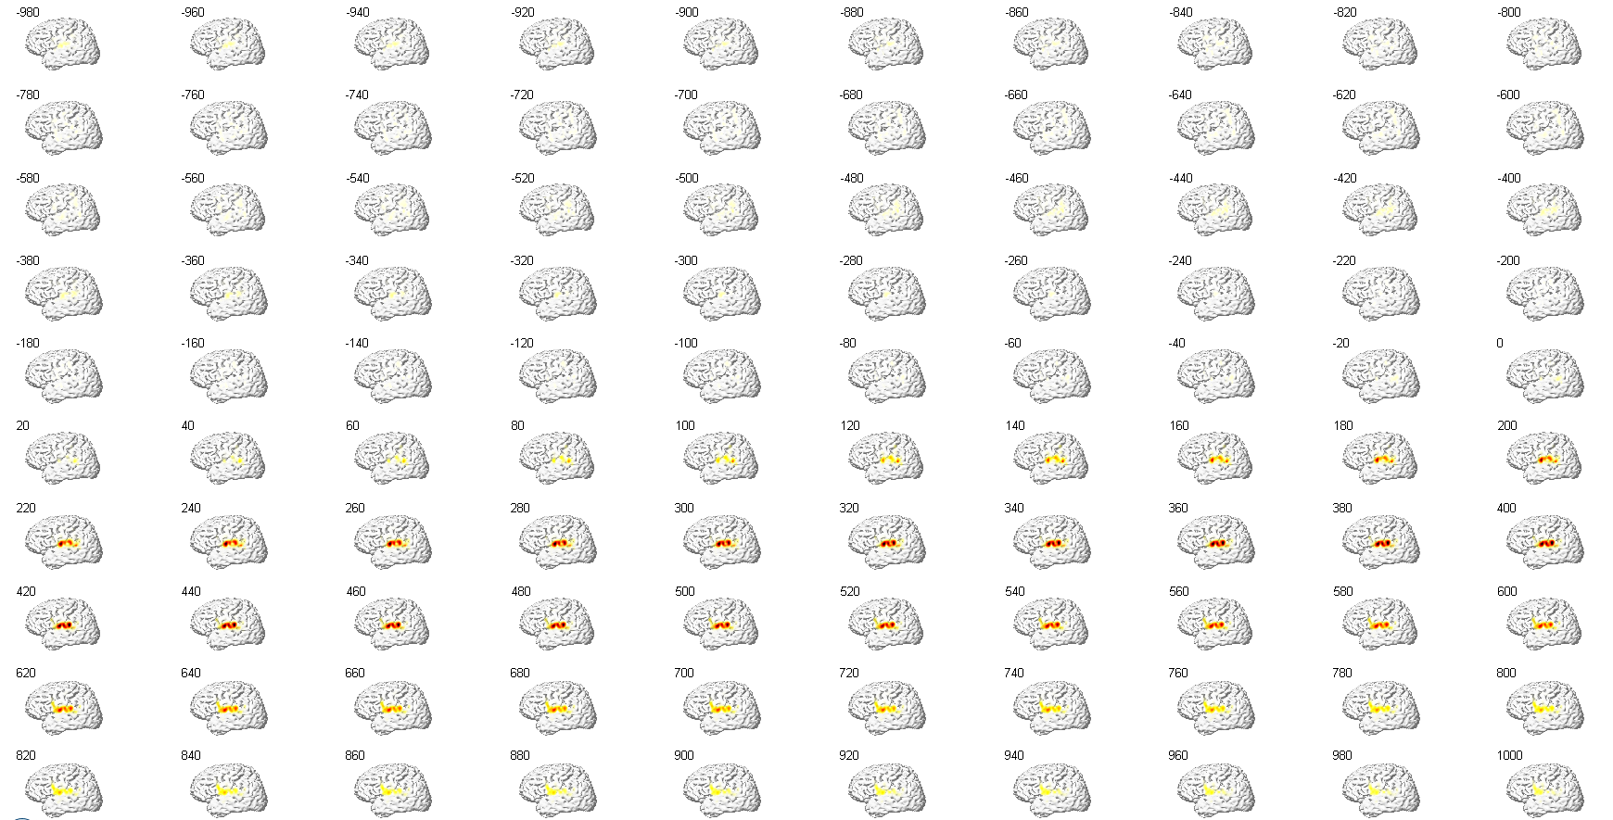
EC29

Slide 18
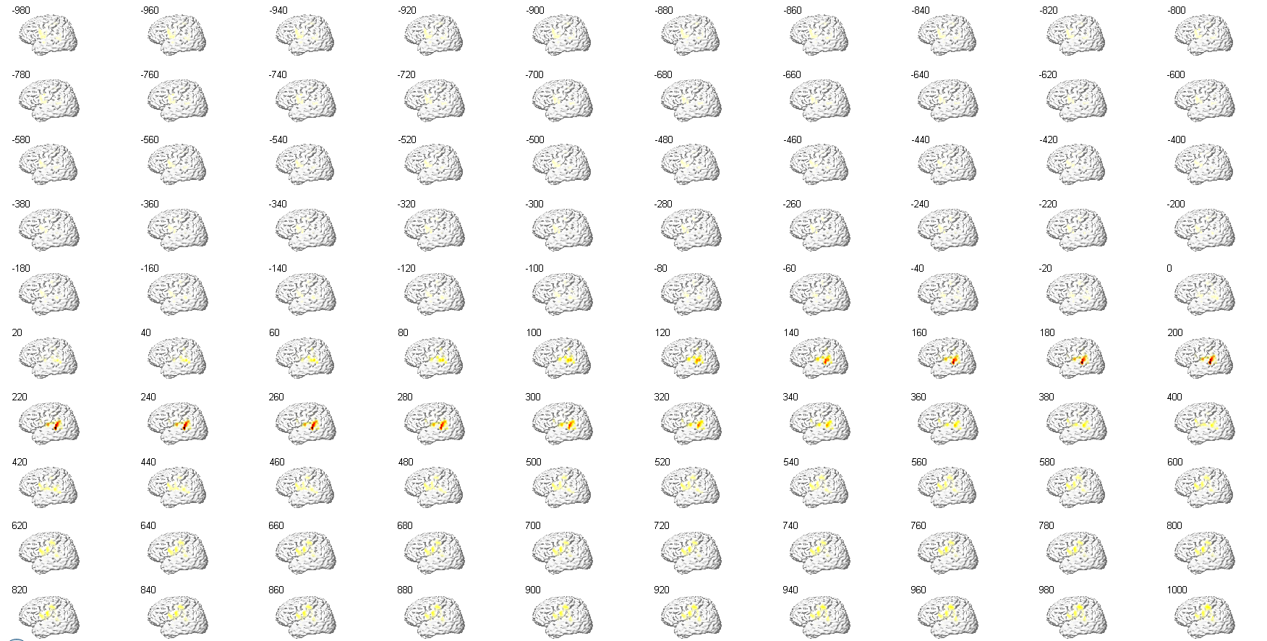
EC29

Slide 19
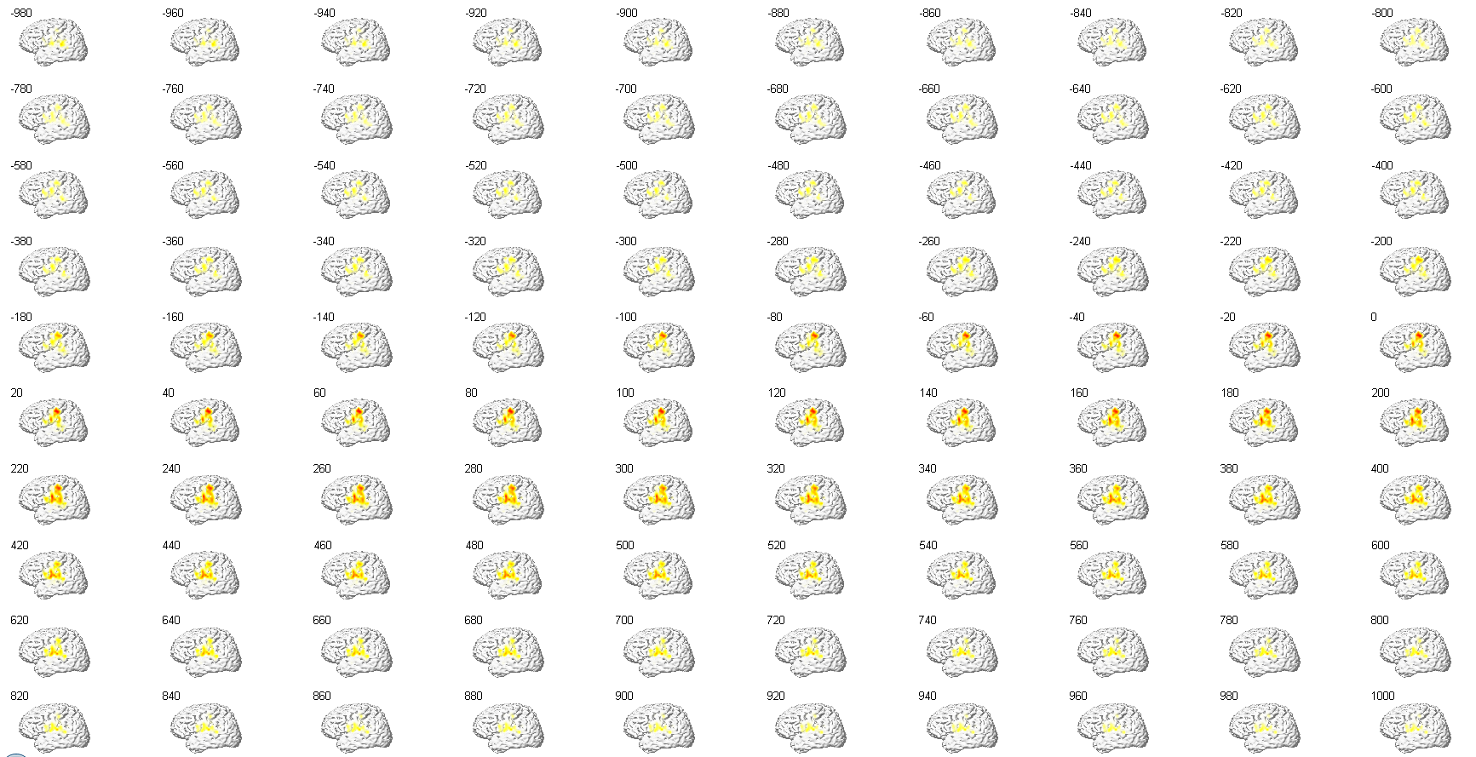
EC29

Slide 20
Stimulation Probabilities

Slide 21
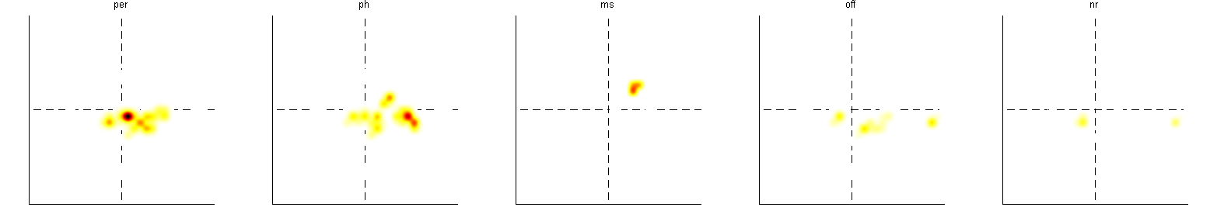

Slide 22
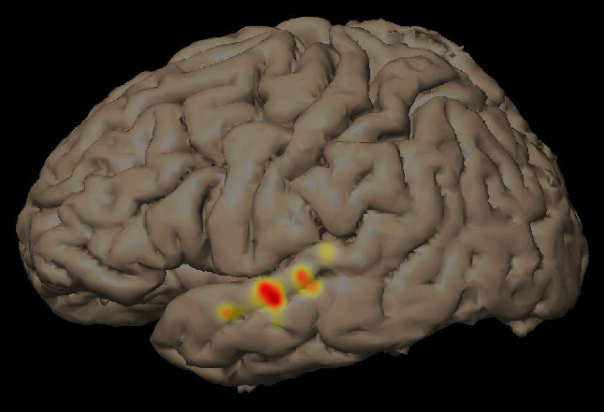
Per

Slide 23
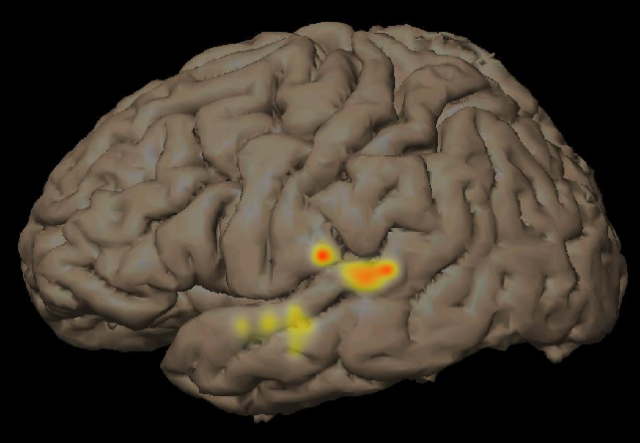
Ph

Slide 24
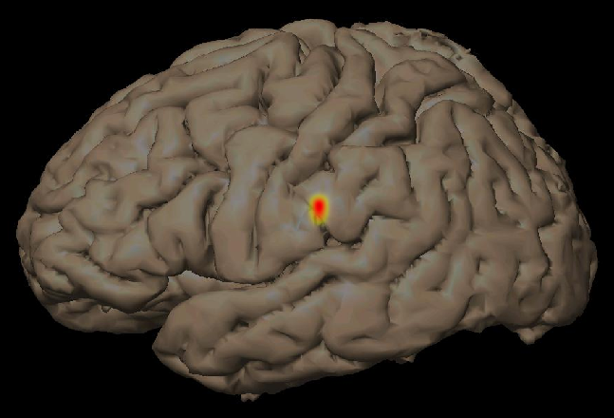
Ms

Slide 25
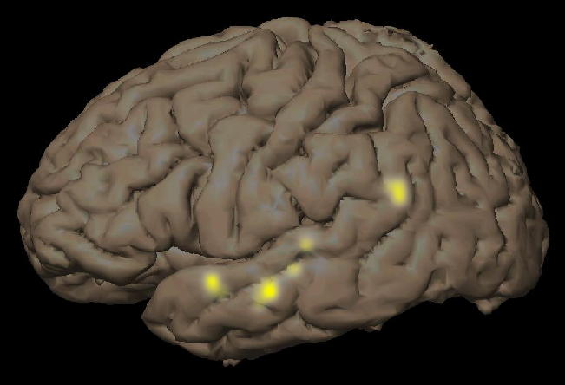
Off

Slide 26
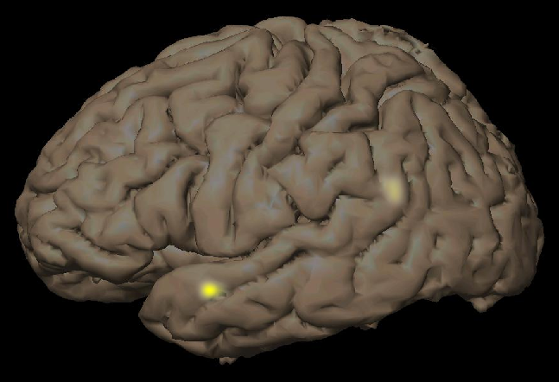
NR

Slide 27
MEDIAN PEAK TIME

Slide 28
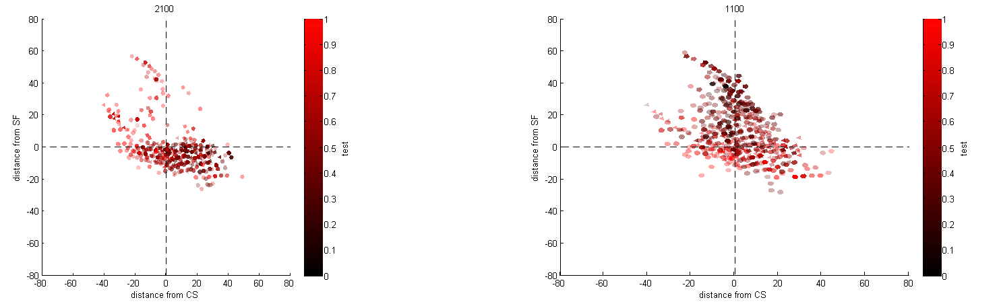
Perception
Production

Slide 29
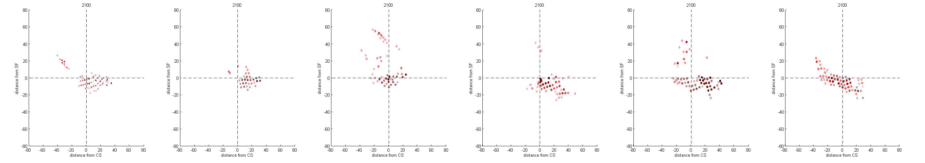
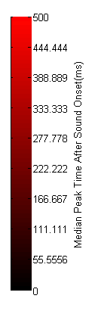
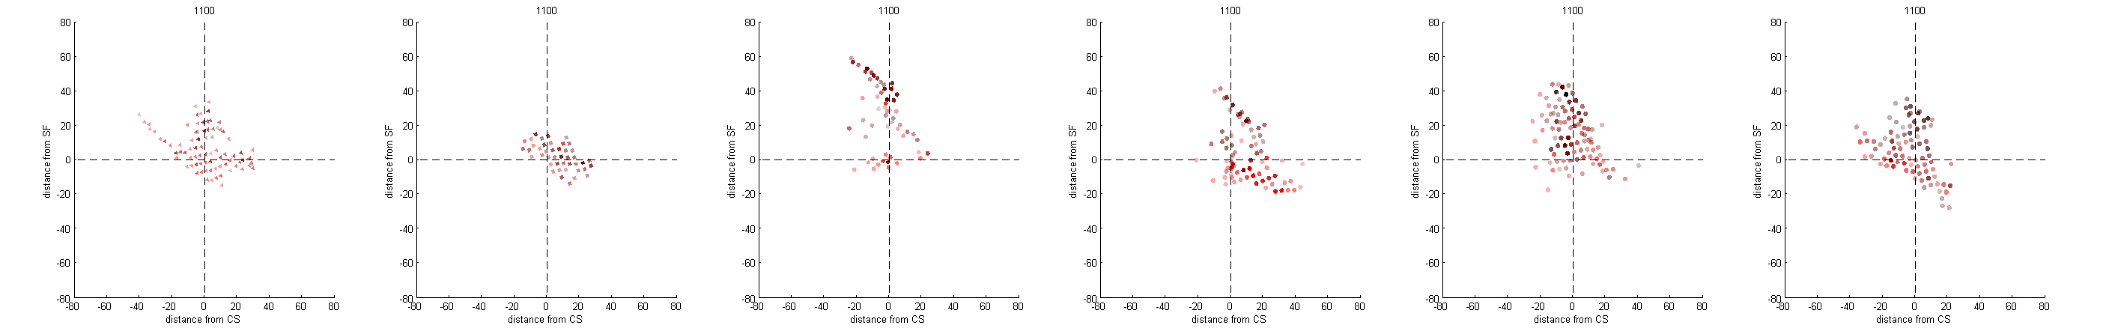
Peak Times Per Subj
Perception
Production

Slide 30
Response type

Slide 31
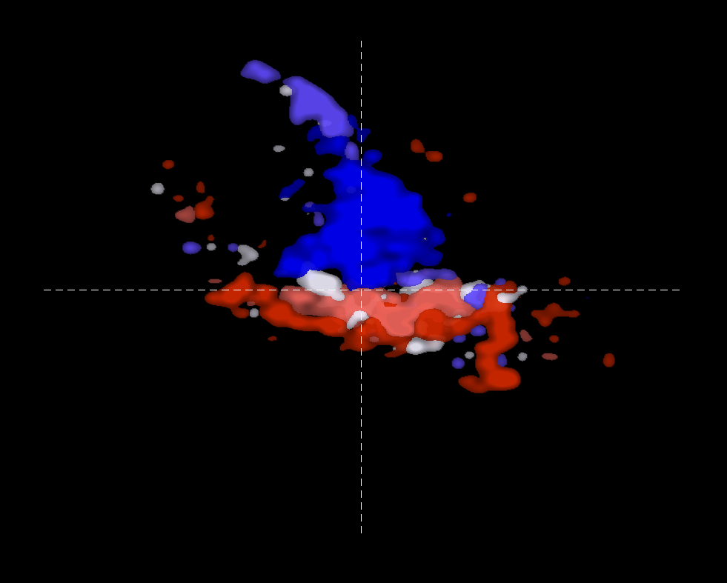
Response Type

Slide 32
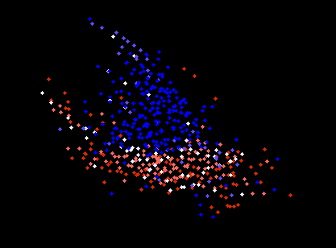

Slide 33
Notes:
1= equal
2= perc
5= [prod
Columns=subj
Rows=response type

Slide 34
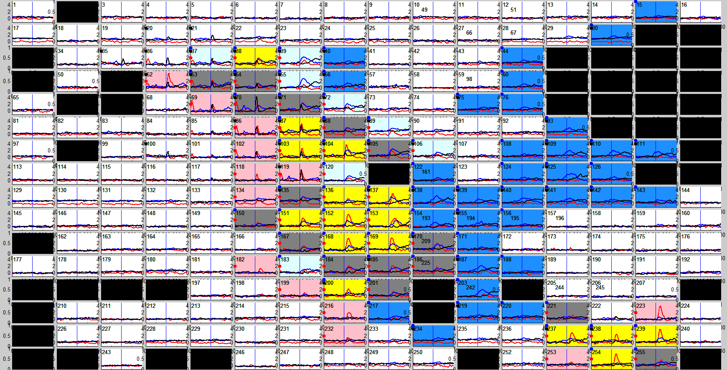

Slide 35
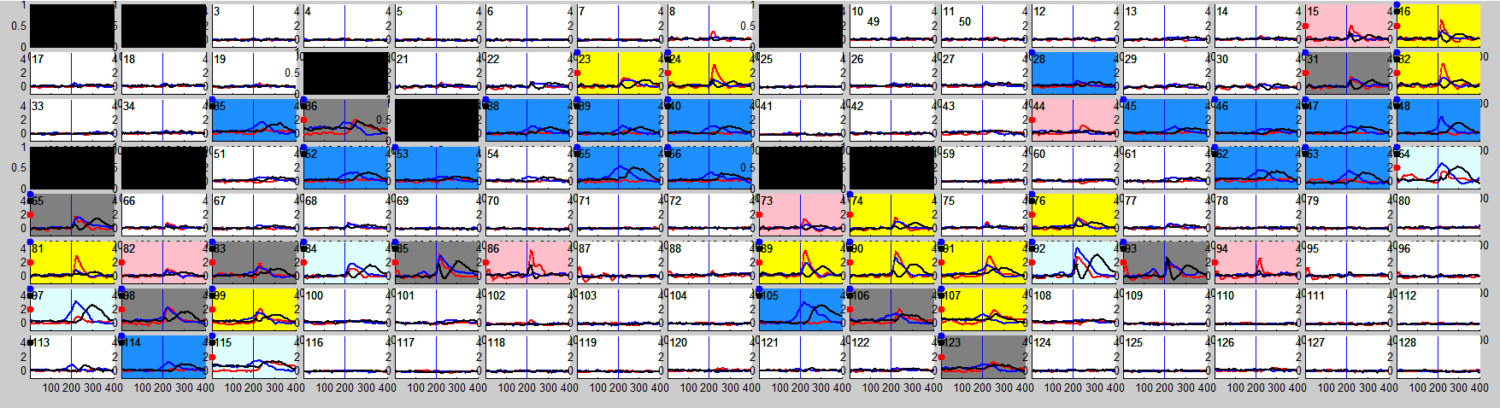

Slide 36
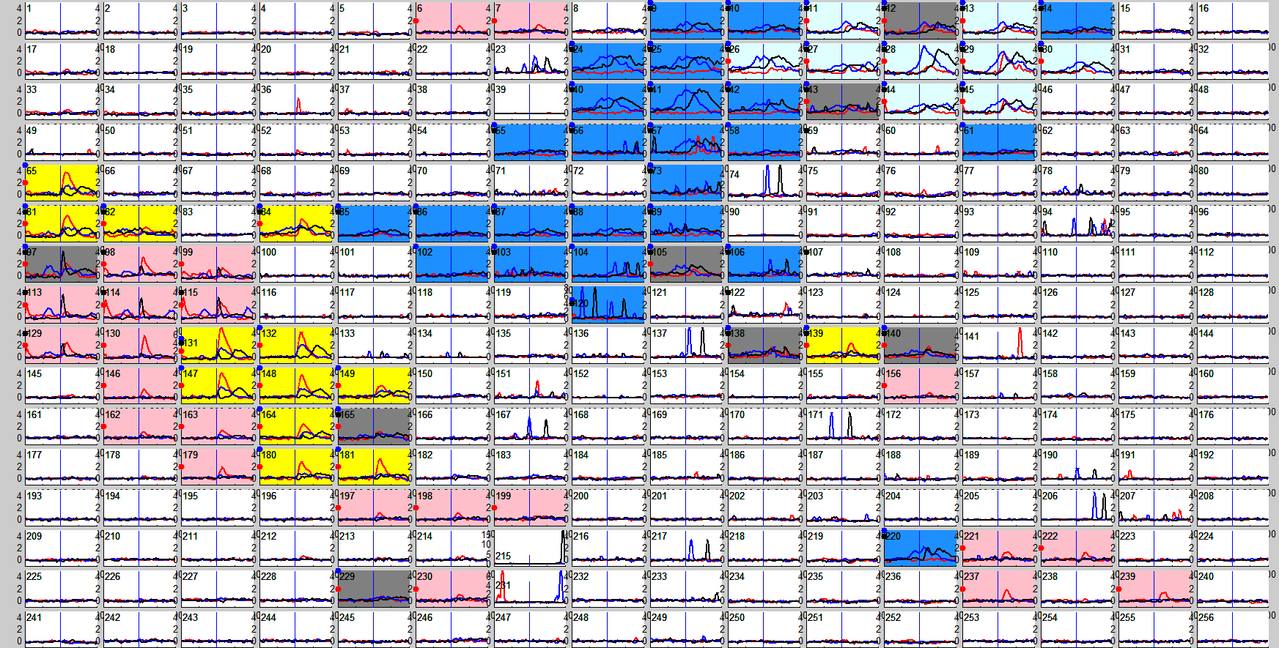

Slide 37
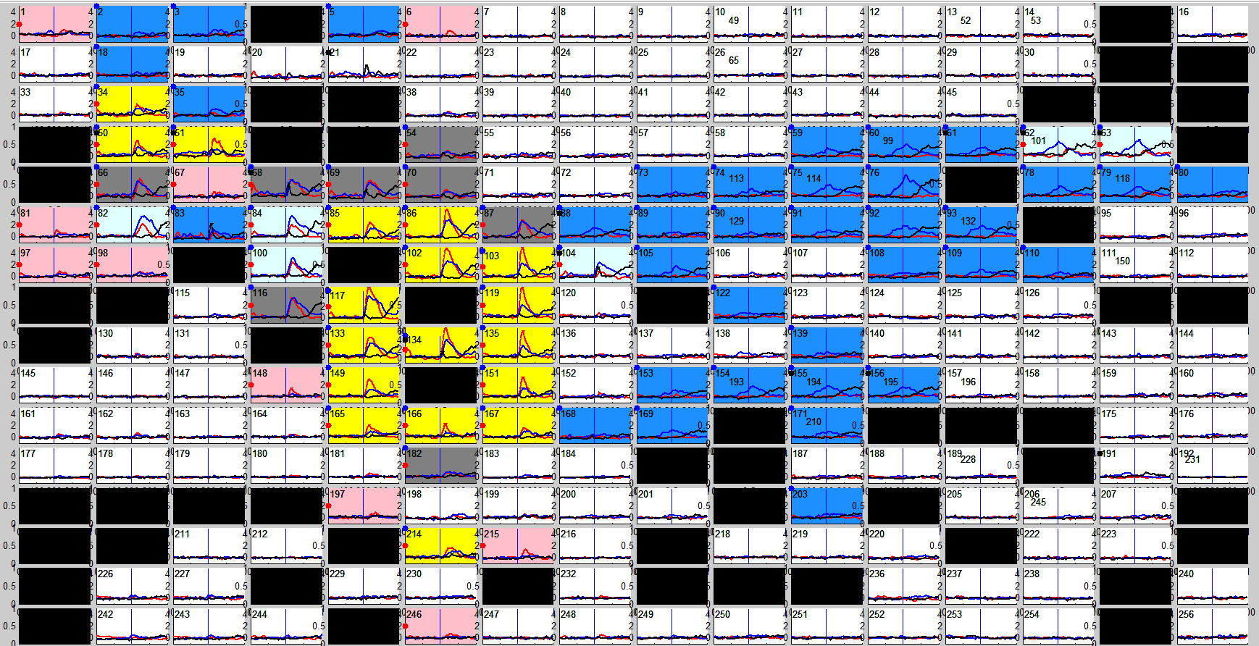

Slide 38
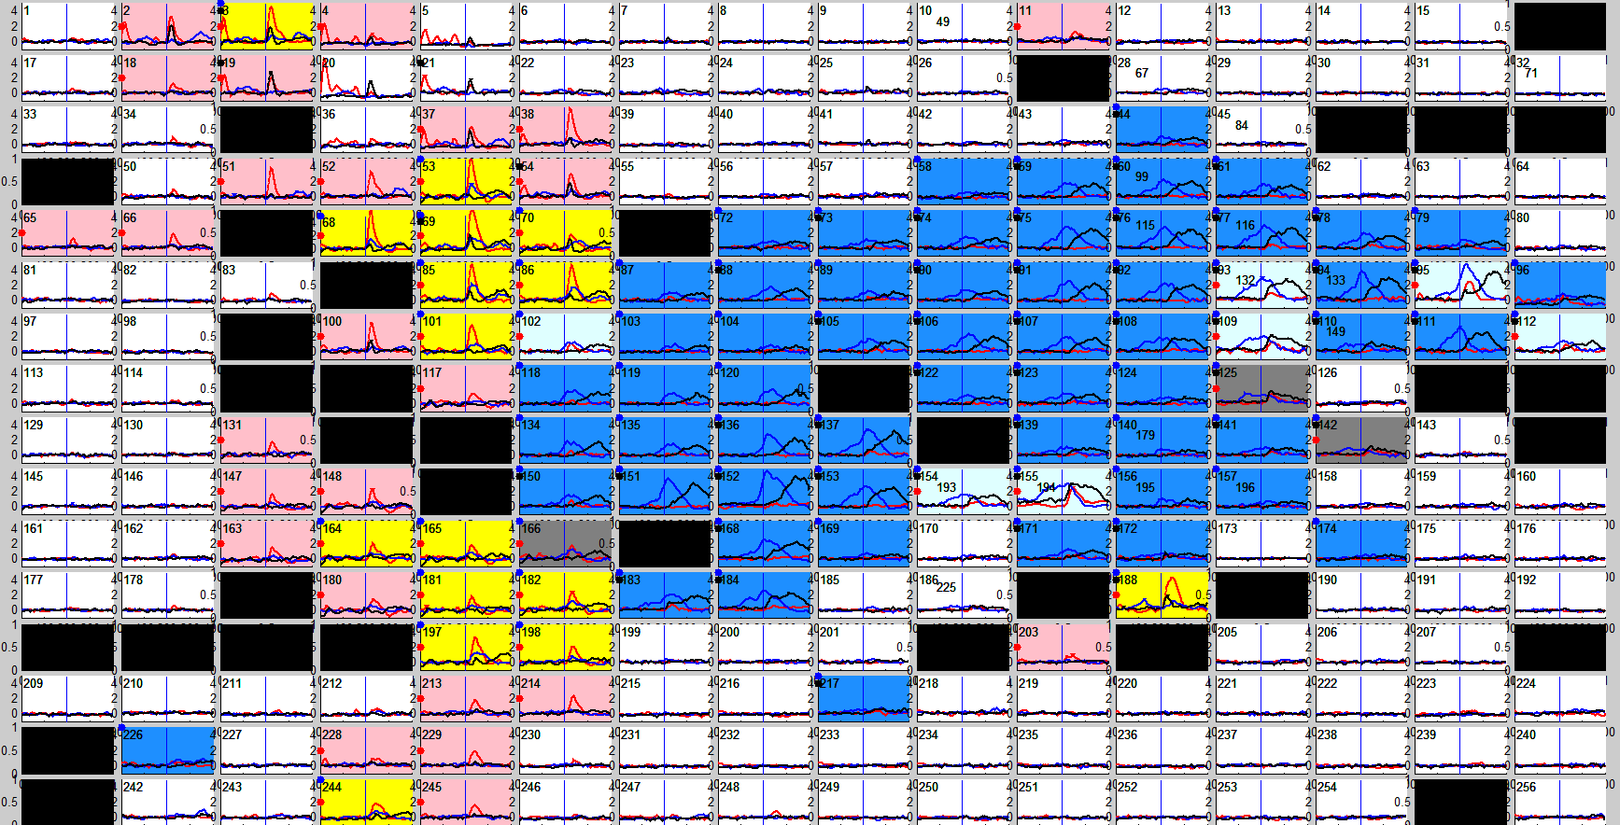

Slide 39
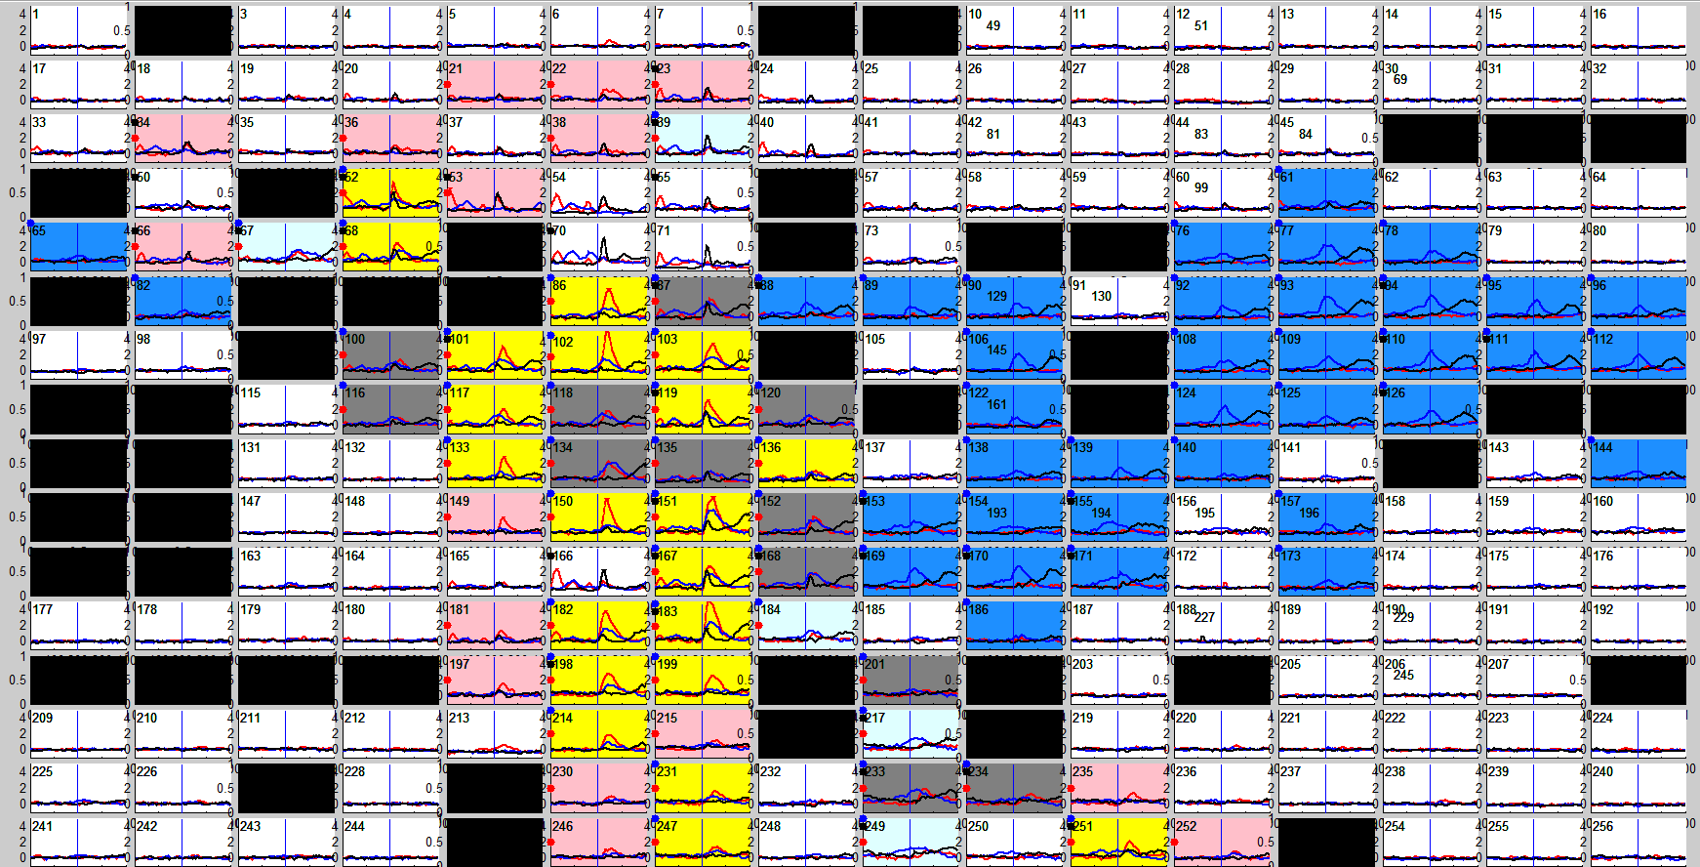

Slide 52
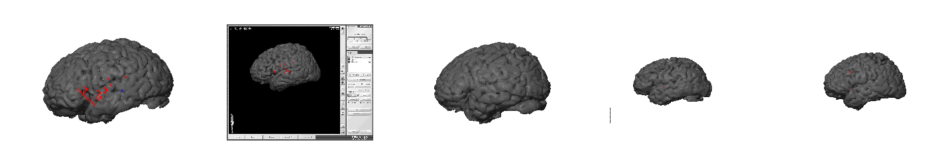
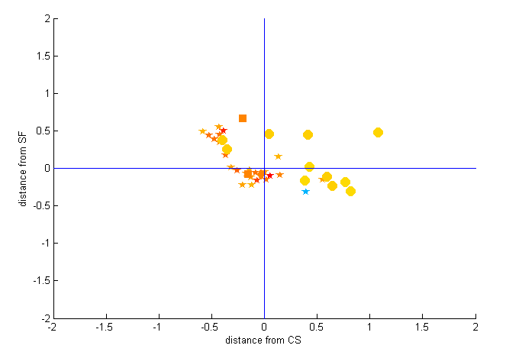

Slide 53
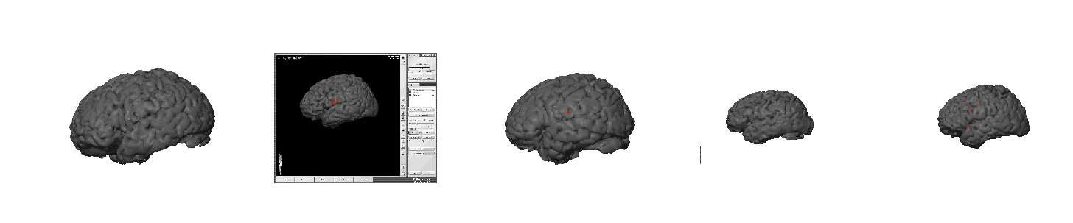
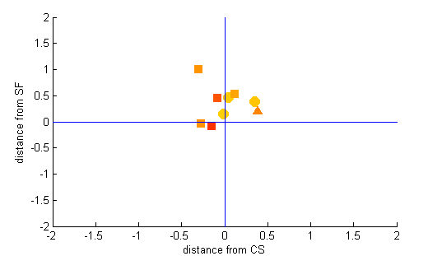
Corr WL (controlled f)

Slide 54
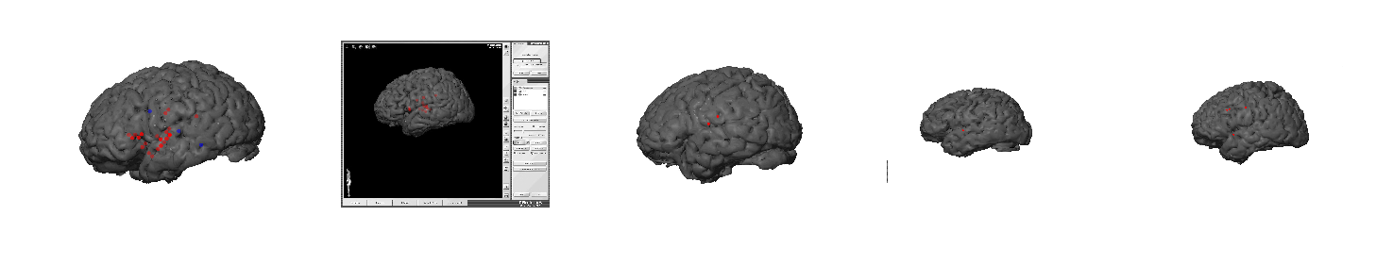
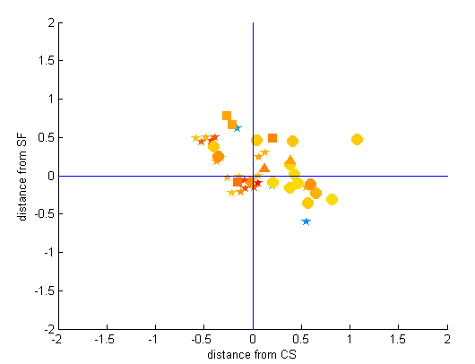
Corr WL

Slide 55
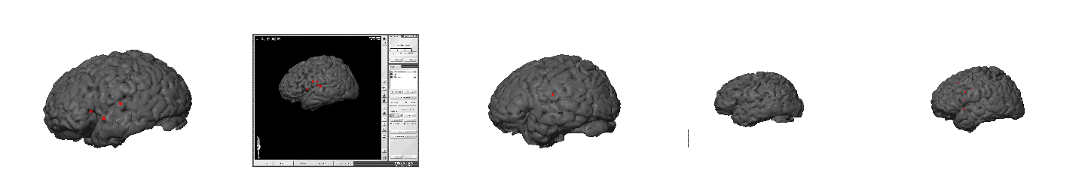
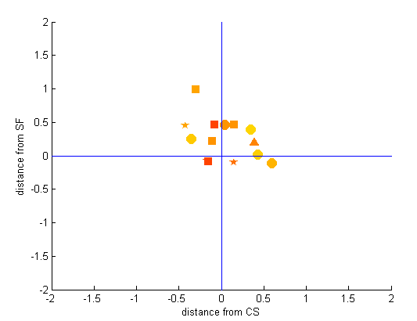
Corr WL

Slide 56
EC23

Slide 57
EC23
Notes:
Perception and Production Long words

Slide 58
EC28

Slide 59
EC18

Slide 60
EC22

Slide 61
EC23

Slide 63
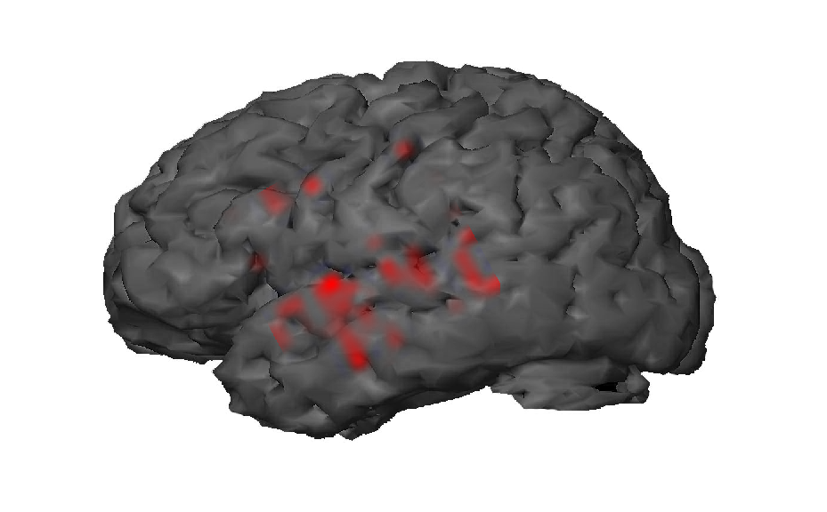
Greater during production

Slide 64
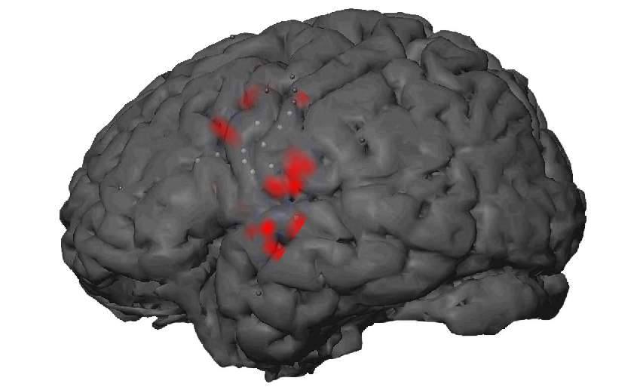
Greater during production
Notes:
EC22

Slide 65
EC28

Slide 66
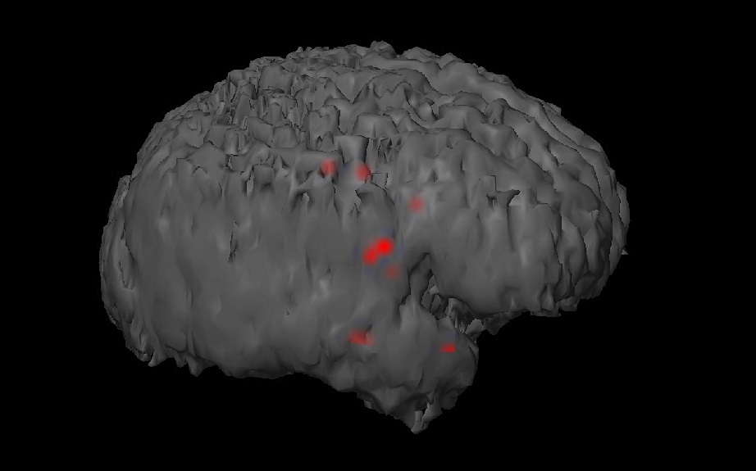
T-test active passive

Slide 67
Notes:
Active(b) vs Passive ®
One tailed t-test. FDR corrected. a<0.01
EC28_B49 vs EC28_B50
Aligned Word Onset

Slide 70
Notes:
Real (b) vs pseudo ®
long words with matching R/P
Two tailed t-test. FDR corrected. a<0.01
EC28_B49 Active Rep
Aligned Word Onset

Slide 71
EC18
Mic during rep
Just to beep

Slide 72
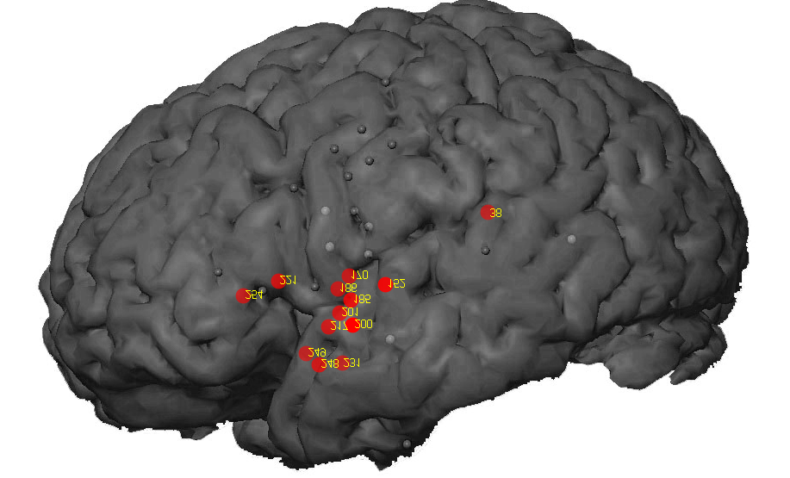
EC18 perc
WL to maxidx
WL to max
Notes:
Controlling for difficulty and frequency

